Slide 1

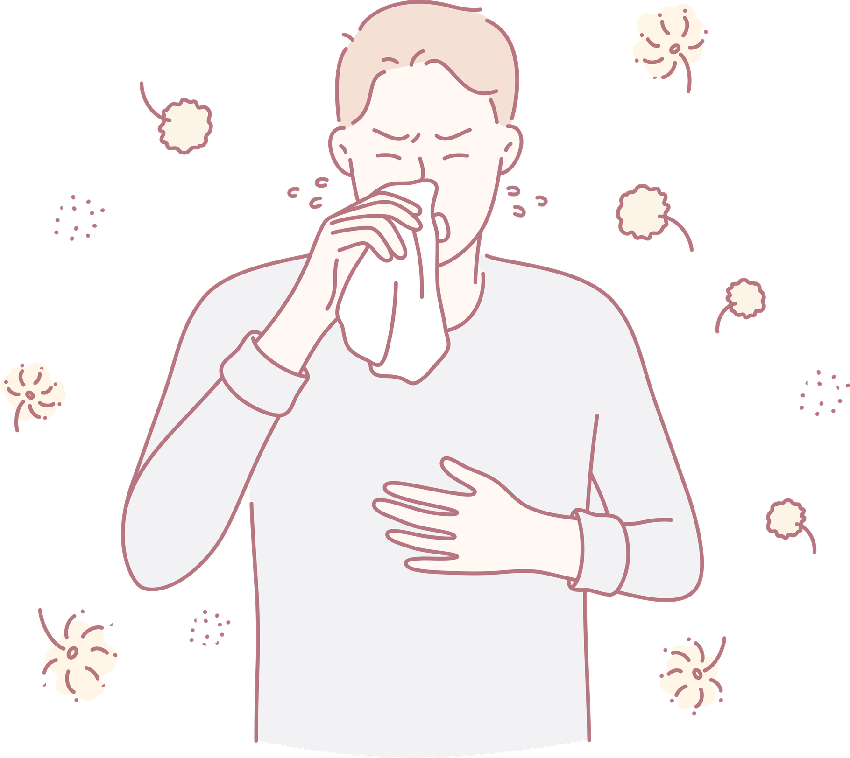
Project Guide: Dr: Y.Lakshmi Prasanna
Department: CS & IT , AIDS
College/University: KLH
Academic Year: 2026–2027
RARE-DISEASE DETECTION USING DBSCAN
Presented by:
Aaskash.B-2520080039
Pranav.R-2520090109

Slide 2

INTRODUCTION
  Machine learning is a branch of artificial intelligence that enables computers to identify patterns in data.
  Healthcare datasets contain information such as symptoms, clinical measurements, laboratory results and patient characteristics.
  Rare diseases can be difficult to investigate because some conditions affect relatively few people and may have limited available data.
  Traditional data-analysis methods may not easily reveal complex relationships among multiple medical features.
  Unsupervised learning can explore the underlying structure of data without requiring predefined class labels.
  DBSCAN is a density-based clustering algorithm that groups closely connected observations and identifies noise points.
  This project explores how DBSCAN can support the analysis of unusual patterns in medical datasets.

Slide 3

PROBLEM STATEMENT
  Medical datasets may contain complex patterns that are difficult to identify manually.
  Rare medical cases may not form large, clearly defined groups.
  Supervised learning approaches require labeled training data.
  Traditional clustering algorithms may require the number of clusters to be specified beforehand.
  The objective is to apply density-based clustering to identify unusual patterns in medical data.

Slide 4
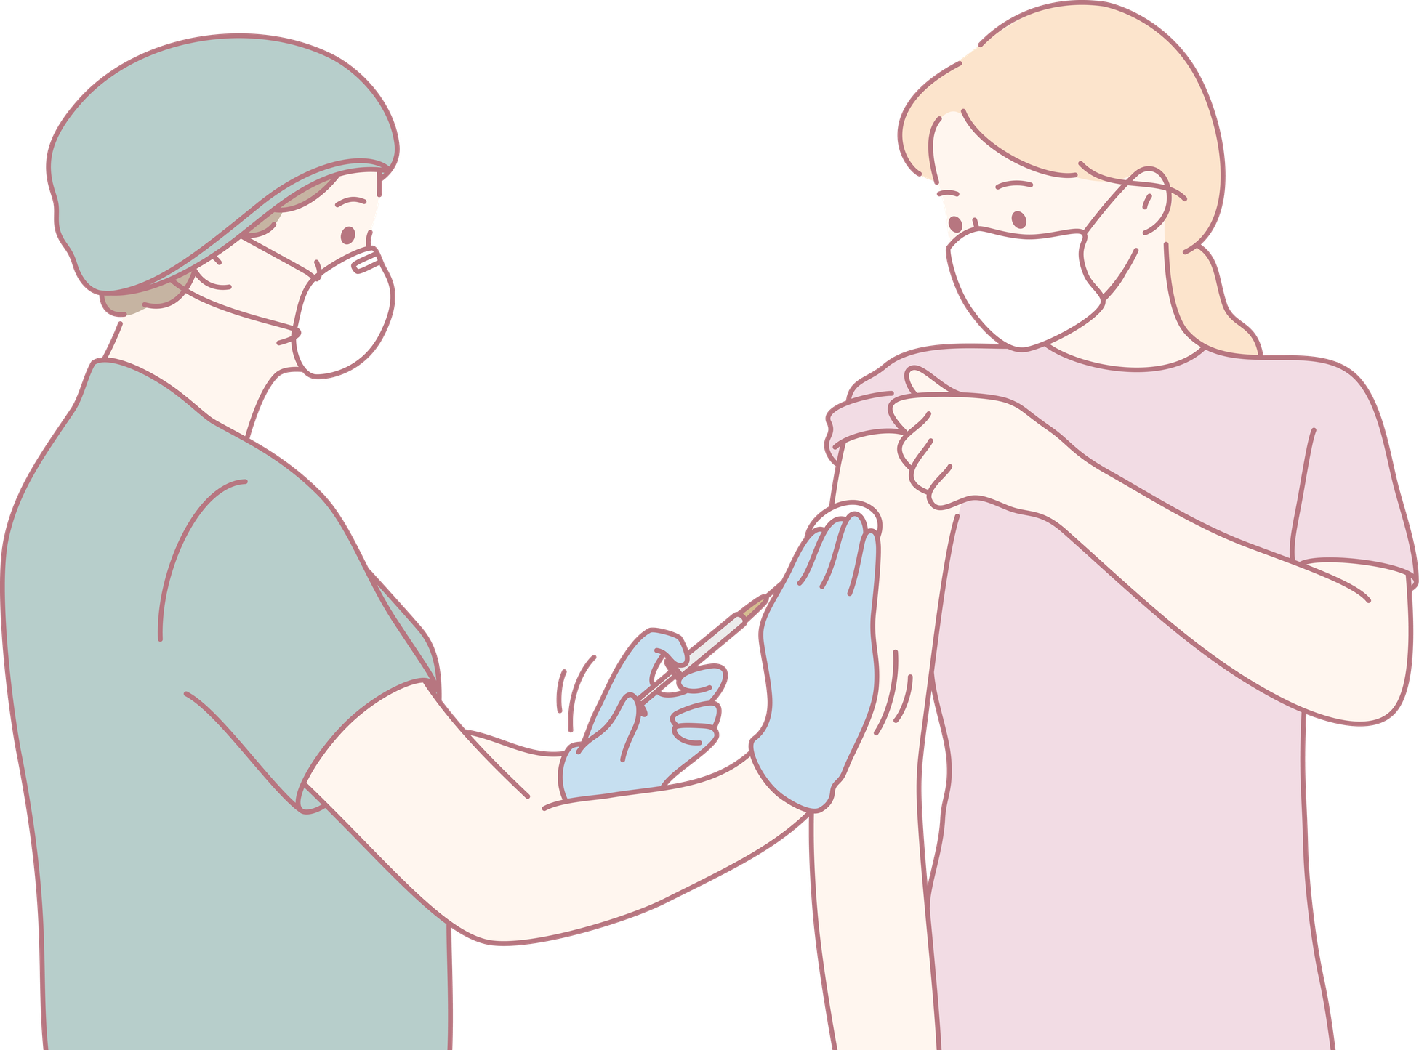
MOTIVATION
  Healthcare analytics: Apply machine learning to extract useful patterns from medical data.
  Unsupervised learning: Explore datasets even when disease labels are unavailable.
  Anomaly detection: Identify observations that differ from dense regions of the dataset.
  Data-driven research: Support the exploration of uncommon feature combinations.
  Algorithmic learning: Understand how distance metrics and local density influence clustering.
  Practical implementation: Build a Python-based application that presents data-analysis results.
  The motivation is to investigate whether density-based clustering can help researchers explore medical records more effectively.

Slide 5

OBJECTIVES
To implement DBSCAN clustering for exploratory analysis of medical data and identification of potentially anomalous observations.
Specific objectives-
  Load and inspect the input dataset.
  Perform exploratory data analysis (EDA).
  Identify relevant features for clustering.
  Apply suitable data preprocessing and feature scaling.
  Configure DBSCAN hyperparameters.
  Assign cluster labels to observations.
  Identify noise points using the assigned labels.
  Visualize cluster distributions and unusual observations.
  Evaluate clustering quality using appropriate metrics, where possible.
  Discuss limitations and possible improvements.

Slide 6
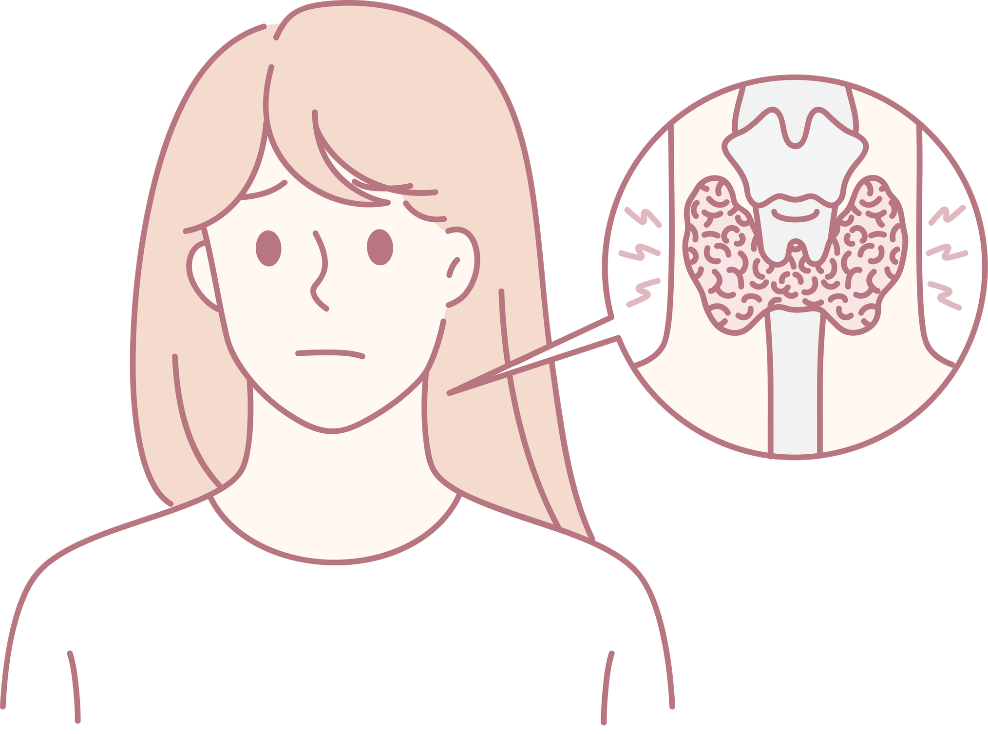
EXISTING SYSTEM
Existing approaches to medical data analysis include manual examination, rule-based systems, supervised classification, and traditional clustering algorithms.
1. Manual analysis
Experts inspect records and measurements to identify unusual cases.
Limitation: Time-consuming for large datasets and dependent on human expertise.
Perform exploratory data analysis (EDA) on the medical dataset.
Apply data preprocessing and feature scaling.
Implement the DBSCAN clustering algorithm.
Identify dense clusters and noise points.
Visualize clustering results and evaluate model performance where reference labels are available

Slide 7
PROPOSED SYSTEM
Improvement over basic clustering: DBSCAN explicitly identifies noise and does not require a predefined cluster count.
Working process:
  Load the dataset from a CSV file.
  Inspect and prepare the input features.
  Handle missing or invalid values where required.
  Scale numerical features when appropriate.
  Configure the DBSCAN parameters.
  Perform density-based clustering.
  Extract cluster labels and noise observations.
  Display and interpret the results.
Expected output:
  Cluster assignment for each observation.
  Number of clusters identified.
  Number of noise points.
  Distribution of observations across clusters.
  Visual representation of the clustering results.
  The proposed system applies DBSCAN to a prepared medical feature matrix.

Slide 8
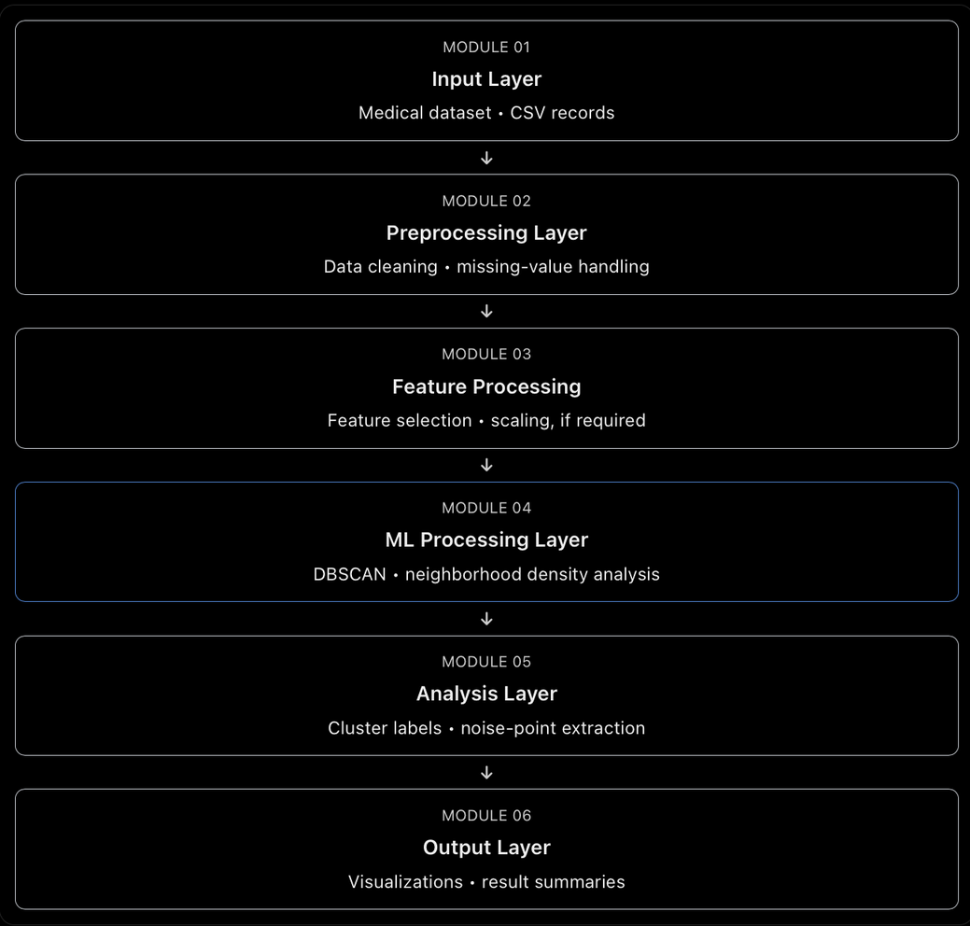
SYSTEM ARCHITECTURE

Slide 9
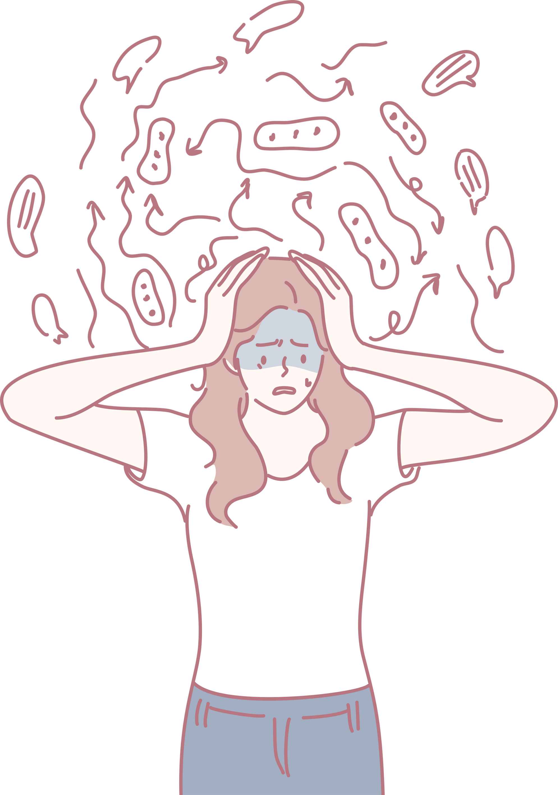
METHODOLOGY / WORKFLOW
The methodology describes the sequence of operations performed by the machine learning system.
  Data acquisition: Read the dataset from a CSV file using Pandas.
  Data understanding: Inspect rows, columns, data types and statistical summaries.
  Exploratory data analysis: Study distributions, missing values and relationships among features.
  Data preprocessing: Clean the dataset and handle missing or invalid values.
  Feature selection: Choose relevant features for the clustering task.
  Feature scaling: Standardize or normalize numerical values if necessary.
  Hyperparameter configuration: Set the eps and min_samples parameters.
  Model fitting: Apply DBSCAN to the prepared feature matrix.
  Cluster assignment: Obtain a label for each observation.
  Noise detection: Identify observations labeled -1.
  Visualization: Plot clusters and unusual observations.
  Evaluation: Analyze cluster quality and compare with reference labels if available.
Workflow diagram: Dataset → EDA → Preprocessing → Feature Scaling → DBSCAN → Cluster Assignment → Noise Analysis → Visualization.

Slide 10
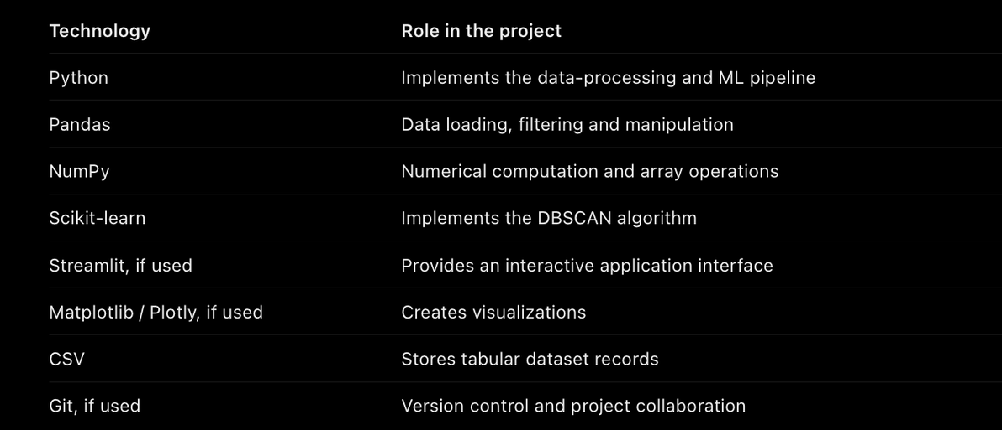
TECHNOLOGY STACK
Why Python?
  Provides widely used machine learning libraries.
  Supports efficient data manipulation.
  Has a large ecosystem for scientific computing.
  Makes it easy to integrate data processing, clustering and visualization.
The exact libraries should match your requirements.txt file.

Slide 11
SYSTEM MODULES / COMPONENTS
Module 1: Data ingestion
Loads the dataset and makes it available for further processing.
Module 2: Data preprocessing
Checks for missing values, duplicates, inconsistent formats and unsuitable data types.
Module 3: Feature processing
Selects relevant attributes and prepares the numerical feature matrix. Feature scaling is especially important when Euclidean distance is used and features have different measurement ranges.
Module 4: DBSCAN clustering
Computes density-based neighborhoods and identifies core points, border points and noise points.
Module 5: Anomaly analysis
Examines records labeled as noise and summarizes their characteristics.
Module 6: Visualization
Presents the cluster structure, noise observations and summary statistics.
Module 7: Evaluation
Assesses clustering quality with appropriate internal metrics or reference labels, where available.

Slide 12
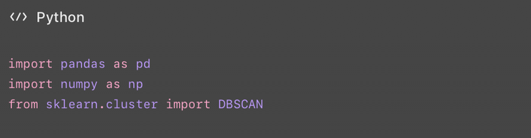
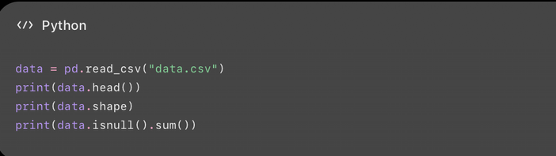
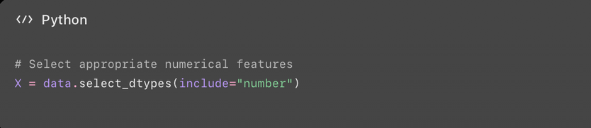
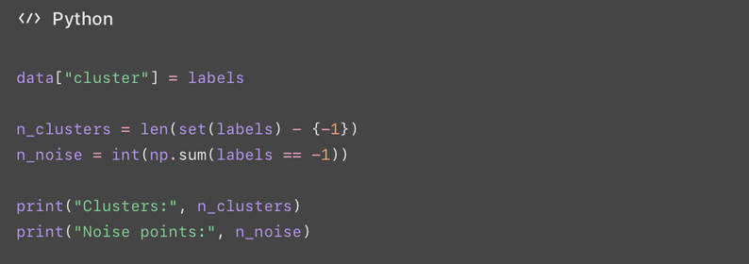
IMPLEMENTATION DETAILS

Slide 13
DATASET DESCRIPTION AND PREPROCESSING
Dataset description
Explain the characteristics of the input dataset.
  Samples: Number of rows or observations.
  Features: Attributes used to represent each observation.
  Feature types: Numerical, categorical or binary variables.
  Source: Origin of the dataset.
  Target labels: Whether verified disease labels are available for evaluation.
Data preprocessing
Preprocessing improves data quality before applying the algorithm.
  Missing-value treatment.
  Duplicate-record removal, where appropriate.
  Conversion of data types.
  Feature selection.
  Categorical encoding when required.
  Feature scaling where appropriate.
Feature scaling
DBSCAN relies on distances between observations. A feature with a much larger numerical range may dominate the distance calculation.

Slide 14
ALGORITHM: DBSCAN
DBSCAN stands for Density-Based Spatial Clustering of Applications with Noise.
It is an unsupervised machine learning algorithm that groups observations according to the density of their local neighborhoods.
Working principle
Calculate the neighborhood of each observation using a distance metric.
Identify core points that meet the minimum density requirement.
Connect density-reachable points to form clusters.
Assign eligible border points to clusters.
Label observations that cannot be assigned to a cluster as noise.
DBSCAN point types
  Core point: Has sufficient samples in its eps neighborhood, including itself.
  Border point: Is within the neighborhood of a core point but does not independently meet the core-point requirement.
  Noise point: Is not assigned to any cluster.
Why DBSCAN?
  Does not require the number of clusters beforehand.
  Supports irregularly shaped clusters.
  Can separate some noise from dense regions.
  Does not require labeled data to perform clustering.

Slide 15

RESULTS AND MODEL
EVALUATION
Results to report
  Total number of input observations.
  Number of clusters detected.
  Number of noise points.
  Percentage of observations classified as noise.
  Number of observations in each cluster.
  Cluster visualization and relevant observations.
Evaluation metrics
Metric
Interpretation
Silhouette Score
Measures how well observations fit within their clusters compared with other clusters
Davies–Bouldin Index
Evaluates the similarity between clusters; lower values are generally preferable
Adjusted Rand Index (ARI)
Compares clustering assignments with reference labels
Precision and Recall
Evaluate detection against verified positive and negative labels, when available

Slide 16
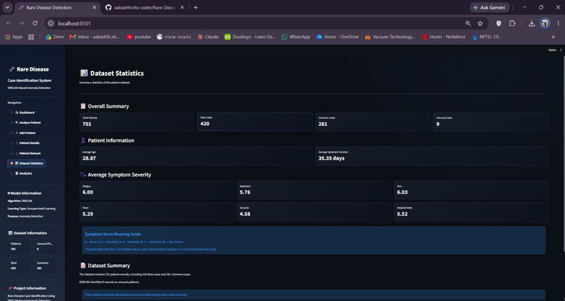
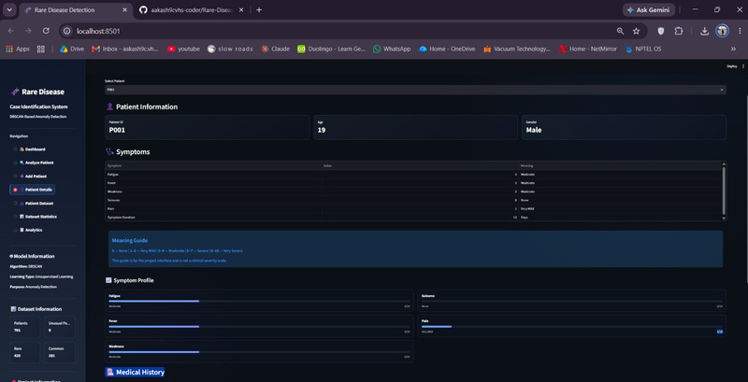
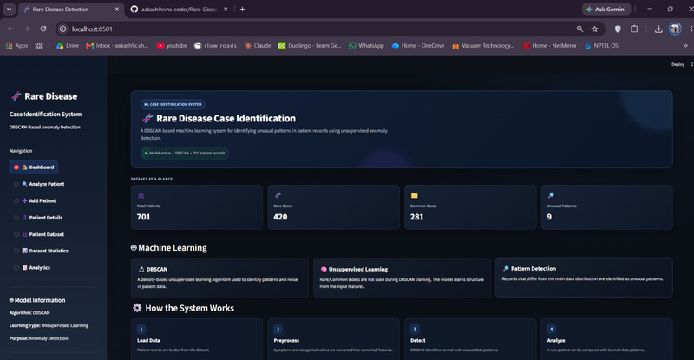
SCREENSHOTS AND DEMONSTRATION
DASHBOARD
ADD PATIENT
PATIENT DETAILS
PATIENT DATASET

Slide 17
  Unsupervised learning: Does not require labeled training data for clustering.
  Automatic cluster discovery: Identifies groups based on local density.
  Noise identification: Assigns a special label to observations outside detected clusters.
  Flexible cluster shapes: Can detect non-spherical clusters.
  Exploratory data analysis: Helps discover structures that may not be obvious from summary statistics.
  Reduced manual effort: Processes multiple observations automatically.
  Visual interpretation: Cluster plots can make the data structure easier to understand.
These advantages describe the algorithm's capabilities and do not guarantee that every rare disease or anomaly will be detected.
ADVANTAGES OF THE PROPOSED SYSTEM

Slide 18
Healthcare and biomedical research
  Exploring patient-record clusters.
  Identifying unusual laboratory measurements.
  Investigating uncommon combinations of clinical features.
  Examining possible anomalies in biomedical datasets.
APPLICATIONS
For your presentation, emphasize healthcare applications because they align with the project's domain. Avoid claiming clinical effectiveness unless it has been validated.
Other domains
  Fraud and transaction anomaly analysis.
  Network intrusion detection.
  Geographic and spatial data clustering.
  Manufacturing defect analysis.
  Customer segmentation and behavioral analysis.

Slide 19
LIMITATIONS OF THE PROJECT
Algorithmic limitations
  DBSCAN is sensitive to the eps and min_samples parameters.
  Clusters with different densities may be difficult to identify using one global eps value.
  High-dimensional data can weaken the usefulness of distance-based neighborhoods.
  Irrelevant features can reduce clustering quality.
Dataset limitations
  Missing or noisy values may affect the results.
  Biased or unrepresentative samples may produce misleading patterns.
  Limited ground-truth labels can make evaluation difficult.
  Feature selection and scaling influence the clustering outcome.
Medical limitations
  A noise point is not automatically a rare-disease case.
  A rare-disease case may belong to a normal cluster.
  The algorithm does not establish a medical diagnosis.
  Expert interpretation and clinical validation are required.

Slide 20
FUTURE SCOPE
The project can be extended using additional machine learning techniques.
  Hyperparameter optimization: Systematically evaluate different values of eps and min_samples.
  Algorithm comparison: Compare DBSCAN with K-Means, hierarchical clustering and other density-based methods.
  Dimensionality reduction: Use PCA for exploratory analysis or visualization of high-dimensional features.
  Advanced anomaly detection: Evaluate methods such as Isolation Forest or Local Outlier Factor.
  Model evaluation: Use expert-verified labels and appropriate performance metrics.
  Feature importance and interpretation: Investigate which attributes distinguish noise observations from cluster members.
  Interactive dashboard: Provide clearer charts, filtering and downloadable reports.
  Larger datasets: Evaluate generalization across datasets and patient populations.
  Privacy and security: Implement safeguards for sensitive medical data.
  Clinical collaboration: Work with medical experts to determine whether detected patterns are meaningful.

Slide 21
CONCLUSION
The Rare-Disease Detection Using DBSCAN project explores the application of unsupervised machine learning to medical data analysis.
DBSCAN identifies density-based clusters and assigns noise labels to observations that do not belong to any discovered cluster. This provides a method for exploring unusual patterns without requiring the number of clusters to be specified in advance.
The project demonstrates important machine learning concepts, including data preprocessing, feature representation, density-based clustering, anomaly identification and result visualization.
The identified noise points may provide useful candidates for further investigation. However, they cannot be treated as confirmed rare-disease cases without appropriate medical evidence.
Future improvements can include hyperparameter optimization, comparison with alternative algorithms, evaluation using verified labels and validation with medical experts.

Slide 22
THANK YOU
VERY MUCH

